Slide 1
Similarity Measures/Metrics

Slide 2
Semantic Relatedness
Semantic relatedness indicates degree to which words are associated via any type (such as synonymy, Antonym, hyponymy, hypernymy and other types) of semantic relationships.
Semantic similarity is a special case of relatedness and takes into consideration only hyponymy/hypernymy relations

Slide 3
Semantic Similarity
Semantic similarity is a concept where a set of documents or terms within term lists are assigned a metric based on the likeness of their meaning / semantic content.
Many automatic measures of semantic similarity/relatedness, is usually a number between -1 and 1, or between 0 and 1. 1 signifies extremely high similarity/relatedness, and 0 signifies little-to-none.

Slide 4
Various Similarity Measures
Similarities (distances) are a set of rules that serve as criteria for grouping or separating objects.
Euclidean Distance
Cosine Similarity
Jaccard Coefficient
F-SCORE
Pearson Correlation Coefficient
d₂
_{ѳ}
d₁

Slide 5
Pearson Correlation Coefficient (PCC)
In statistics, Pearson correlation(or Pearson correlation coefficient) refers to the measure of the linear dependence between two variables .
this metric measures how highly correlated are two variables and is measured from -1 to +1.
The closer the coefficient is to 1 or -1, the more closely they are related. If the coefficient is close to zero, it means that there is no relationship between the two distance variables.

Slide 6

Cont’d
If sample X_{k} has n measurements, or features, it can be written as X_{k}{x_{1k}, x_{2k},…x_{nk}}. The above formula to calculate r can be written as follows.

Slide 7
Problem1 Masquerade user detection

Slide 8
Masquerade User Detection
Unauthorized users usually attempt to impersonate legitimate user’s account to gain access to computer systems that they are not authorized to enter. This poses a severe security problem for privacy and computer usage. The problem is called masquerade or spoofing.
Masquerade detection, is an important capability for defending a computer system against such intrusion.

Slide 9
Proposed Approach
Training Data
Discover Command Strings
Training Phase
Set of Command Strings
Testing Data blocks
Command String Comparator
Score Generator
Testing Phase
Valid or Masquerade Block

Slide 10
Data Set
The first data set collected by Schonlau et al. is used for masquerade detection . The data include command traces, which come from the UNIX account audit mechanism. The data set provides 15,000 commands (150 blocks of 100 commands each) for each of 70 users. 50 users are selected randomly to serve as intrusion targets. Then the other 20 users are used as masquerade. For the 50 users, the first 50 blocks (5,000 commands) are used as training data. From blocks 51 to 150, the 20 users’ data are shuffled into the 50 users’ data, which are used as test data.

Slide 11
Training Phase
Discover Command Strings:
Find unique commands in all users
Construct a frequency matrix
Calculate the correlation coefficient for all pair of unique commands
Combine the commands pair having maximum correlation coefficient
Generate Command strings

Slide 12
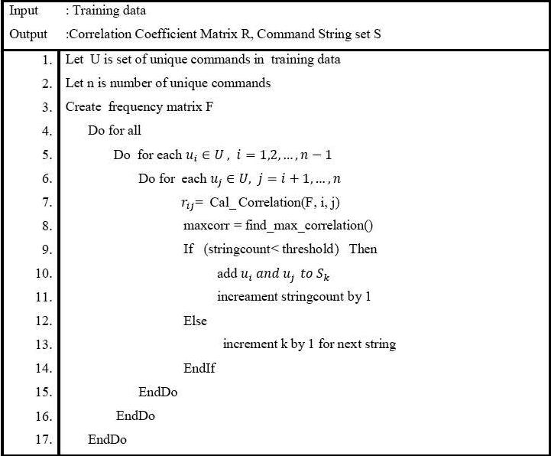
Algorithm

Slide 13
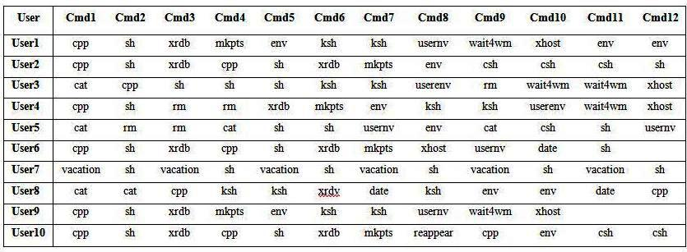
Illustration(Training Phase)

Slide 14
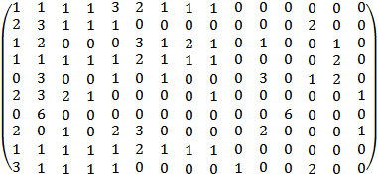
The list of unique commands found in 10 users is:
cpp, sh, xrdb, mkpts, env, ksh, usernv, wait4wm, xhost, reappear, cat, vacation, csh, rm, date
Frequency matrix for the Sample data
Each column represents frequency of unique commands (List given in the previous slide) and row represents users.

Slide 15

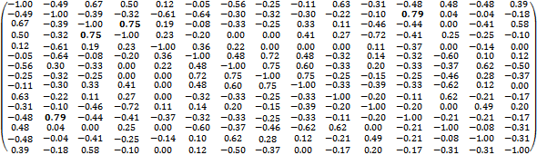
Pearson Correlation Formula

Slide 16
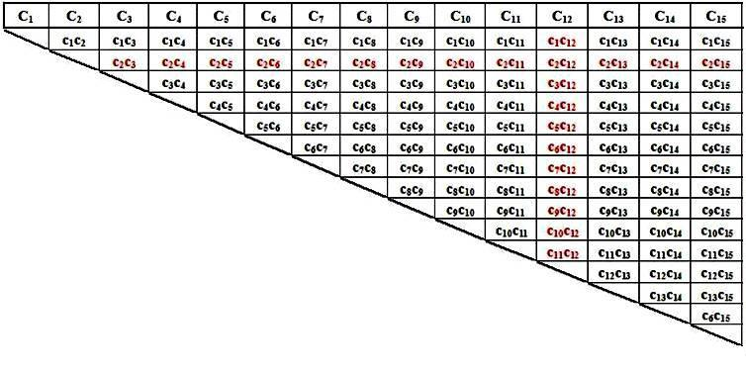
The table illustrates how combination of C₂ and C₁₂ generates new command C₁₆

Slide 17
Possible command strings
Sl # | Pattrens | Correlation Coefficient
P1: | sh, vacation | 0.79
P2: | xrdb, mkpts | 0.75
P3: | xhost, usernv, wait4wm | 0.75
P4: | cpp, xrdb, mkpts | 0.67
P5: | reappear, csh | 0.62
P6: | cat, rm | 0.49
P7: | env, ksh | 0.36
P8: | date, cat, rm | 0.20

Slide 18
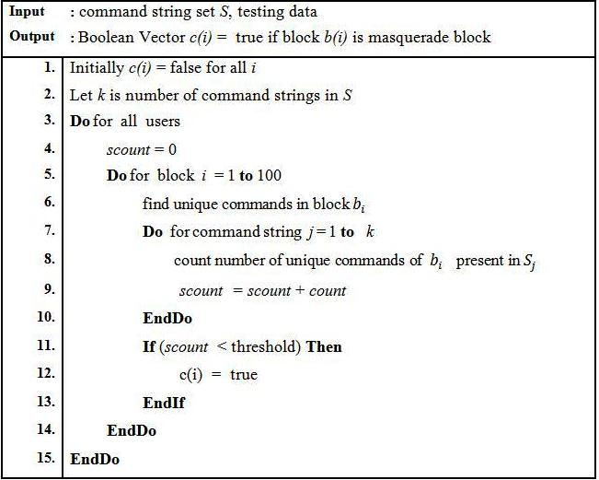
Testing Phase
Step 1 : String Comparator
Step 2 : Score generator

Slide 19

Experimental Analysis(1)
SEA dataset (collected by Schonlau and colleagues).
Misses: number of times masquerade blocks classified as valid blocks
Hit: number of times masquerade blocks classified as masquerade blocks.
Missing alarm: A missing alarm or false negative happened when a masquerade block is classified as legitimate.
False alarm: A false alarm or false positive occurs when the system regards a legitimate user as a masquerader.

Slide 20
Experimental Results
No of false alarm cases = 33 out of 4769 legitimate blocks
false positive rate = 0.69%
No of hit cases = 141 out of 231 masquerade blocks
hit rate = 61.04%.

Slide 21
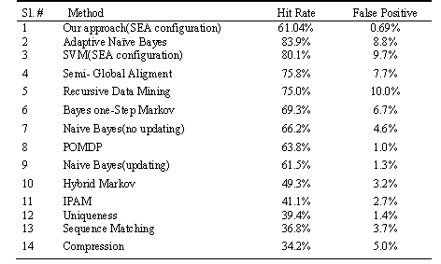

Slide 22
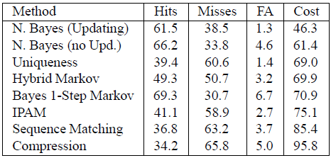
Experimental Results(2)
Maxion et al. proposed a cost function to assess the effectiveness of an intrusion detection scheme in terms of a linear combination of missing alarms and false alarms.
cost = 43.1

Slide 23
Selected References
Dash, S.K., Reddy K.S. and Pujari, A.K., “Adaptive Naive Bayes method for masquerade detection, Security and Communication Networks”, Vol.4(4), p.410–417, 2011.
Schonlau, M., DuMouchel, W., Ju, A.F., Theus, M., and Vardi, Y., “Computer Intrusion: Detecting Masquerades”, Statistical Science, Vol. 16(1), 58–74, 2001.

